Slide 1
Linear Error Analysis An important tool for performance analyses
Jochen Landgraf

Slide 2
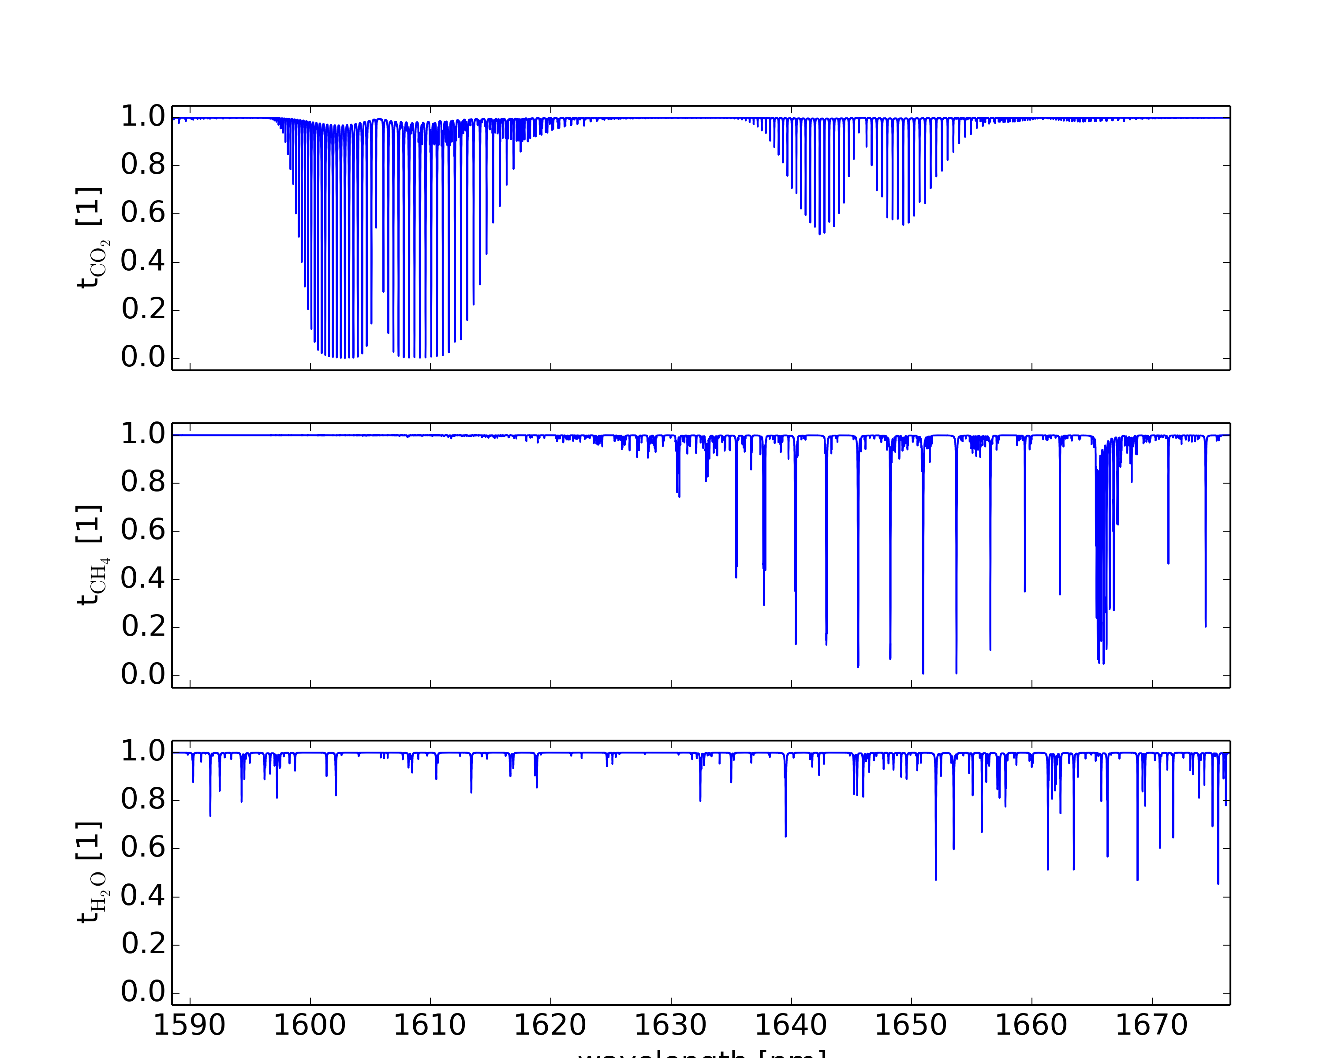
The 1.6 $μm$Spectral Range
Relevant telluric absorber:
CO₂
CH₄
H₂O
Molecular absorption cross sections can be taken from HITRAN data base
Atmospheric concentration to be retrieved from the observation

Slide 3
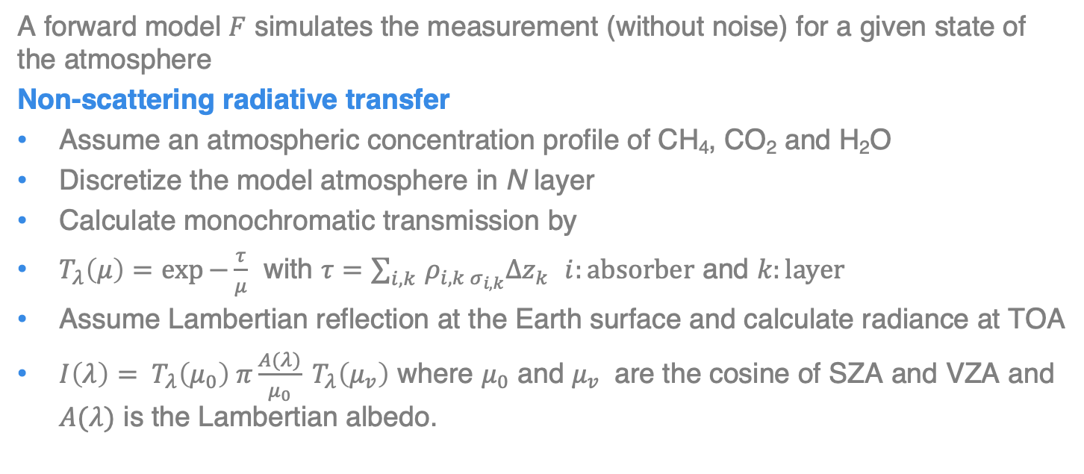
The Forward Model
A forward model $F$ simulates the measurement (without noise) for a given state of the atmosphere
Non-scattering radiative transfer
Assume an atmospheric concentration profile of CH₄, CO₂ and H₂O
Discretize the model atmosphere in N layer
Calculate monochromatic transmission by
$T_{λ}\left(μ\right)=\exp{−\frac{τ}{μ}}$ with $τ=\sum_{i,k }{ρ_{i,k σ_{i,k}}Δz_{k}}$ $i:absorber$ and $k:layer$
Assume Lambertian reflection at the Earth surface and calculate radiance at TOA
${I\left(λ\right)= T}_{λ}\left(μ_{0}\right) π\frac{A(λ)}{μ_{0}} T_{λ}\left(μ_{v}\right)$ where $μ_{0}$ and $μ_{v}$ are the cosine of SZA and VZA and $A(λ)$ is the Lambertian albedo.

Slide 4
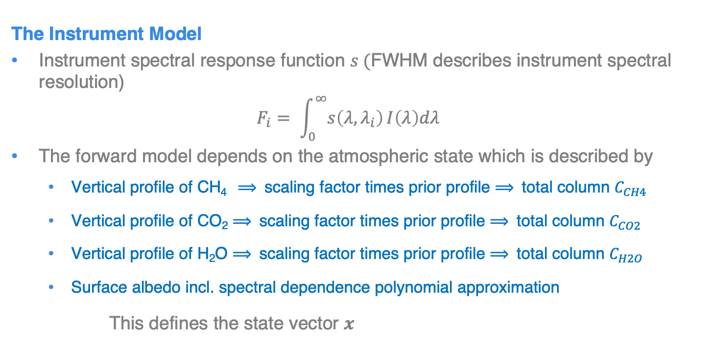
The Forward Model (2)
The Instrument Model
Instrument spectral response function $s ($FWHM describes instrument spectral resolution)
$${F_{i}= \int_{0}^{∞}{s\left(λ,λ_{i}\right)}I\left(λ\right)dλ }_{}$$
The forward model depends on the atmospheric state which is described by
Vertical profile of CH₄ $⟹$ scaling factor times prior profile $⟹$ total column $C_{CH4}$
Vertical profile of CO₂ $⟹$ scaling factor times prior profile $⟹$ total column $C_{CO2}$
Vertical profile of H₂O $⟹$ scaling factor times prior profile $⟹$ total column $C_{H2O}$
Surface albedo incl. spectral dependence polynomial approximation
This defines the state vector $x$

Slide 5
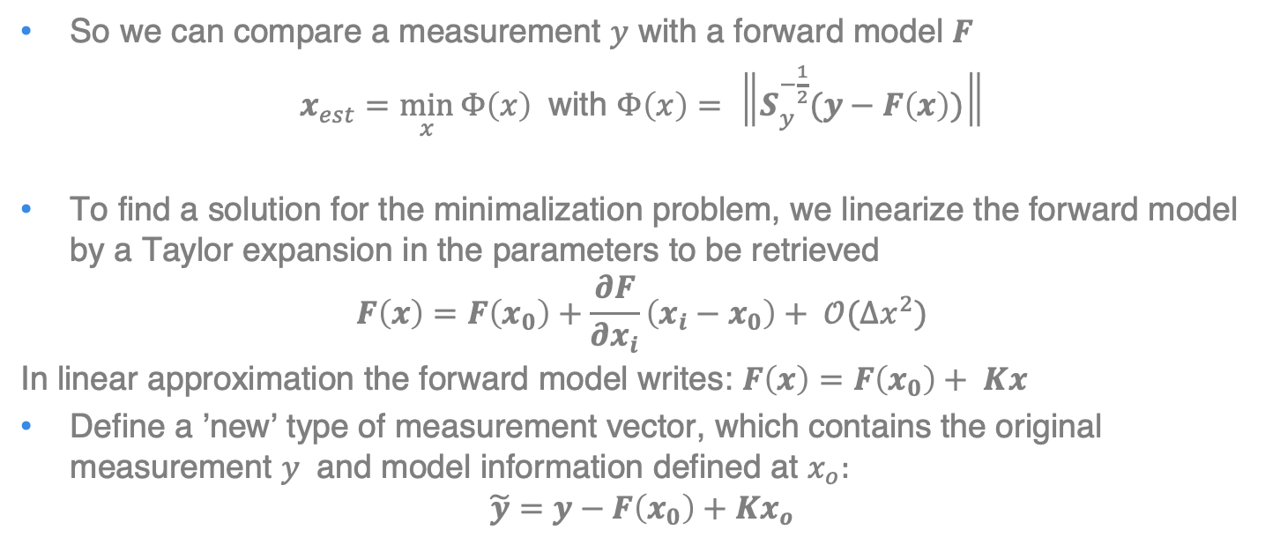
Least squares fit - Inversion of the forward model $F$
So we can compare a measurement $y$ with a forward model $F$
$x_{est}=\min_{x}{Φ\left(x\right)}$ with $Φ\left(x\right)= \left\|S_{y}^{−\frac{1}{2}}(y−F\left(x\right))\right\|$
To find a solution for the minimalization problem, we linearize the forward model by a Taylor expansion in the parameters to be retrieved
$$F\left(x\right)=F\left(x_{0}\right)+\frac{∂F}{∂x_{i}}\left(x_{i}−x_{0}\right)+ 𝒪(Δx^{2})$$
In linear approximation the forward model writes: $F\left(x\right)=F\left(x_{0}\right)+ Kx$
Define a ’new’ type of measurement vector, which contains the original measurement $y$ and model information defined at $x_{o}:$
$$\tilde{y}=y−F\left(x_{0}\right)+Kx_{o}$$

Slide 6
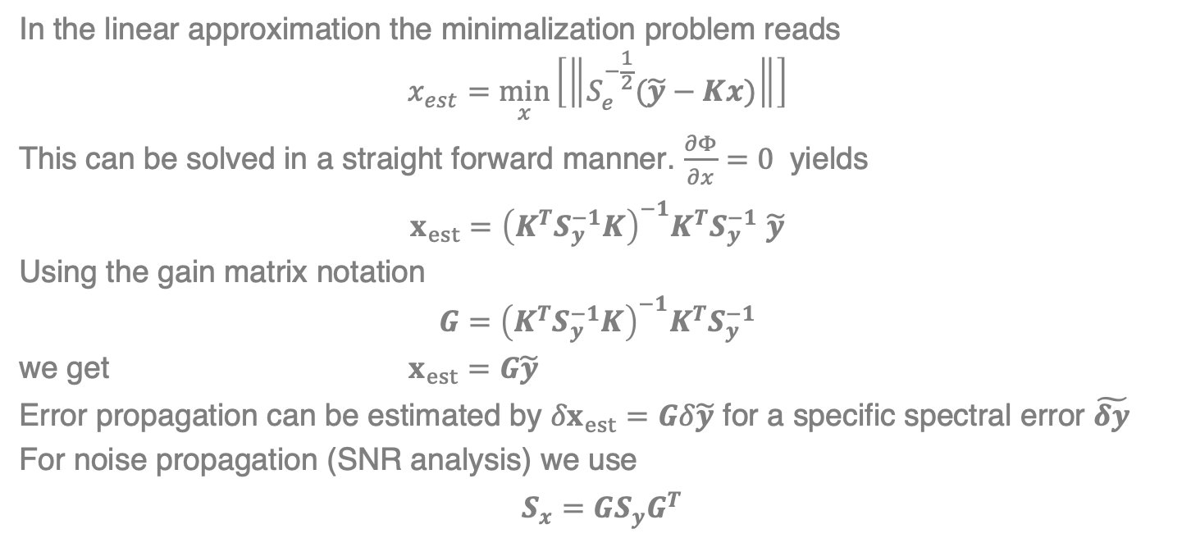
Least squares fit - Error analysis
In the linear approximation the minimalization problem reads
$$x_{est}=\min_{x}\left[\left\|S_{e}^{−\frac{1}{2}}(\tilde{y}−Kx)\right\|\right]$$
This can be solved in a straight forward manner. $\frac{∂Φ}{∂x}=0$ yields
$x_{est}={\left(K^{T}S_{y}^{−1}K\right)}^{−1}K^{T}S_{y}^{−1}$ $\tilde{y}$
Using the gain matrix notation
$${G=\left(K^{T}S_{y}^{−1}K\right)}^{−1}K^{T}S_{y}^{−1}$$
we get $x_{est}=G\tilde{y}$
Error propagation can be estimated by ${δx}_{est}=Gδ\tilde{y}$ for a specific spectral error $\tilde{δy}$
For noise propagation (SNR analysis) we use
$S_{x}=GS_{y}G^{T}$

Slide 7
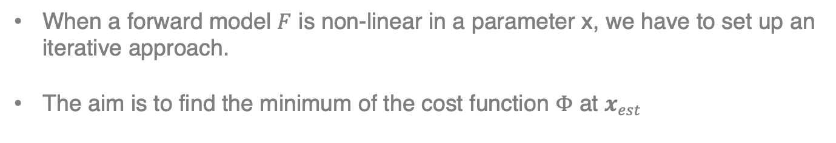




Gauss-Newton Iteration
When a forward model $F$ is non-linear in a parameter x, we have to set up an iterative approach.
The aim is to find the minimum of the cost function $Φ$ at $x_{est}$
$$F$$
$$Φ$$
$$x_{est}$$
$$x_{est}$$

Slide 8



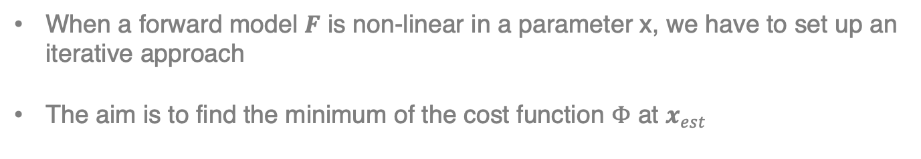





Gauss-Newton Iteration
When a forward model $F$ is non-linear in a parameter x, we have to set up an iterative approach
The aim is to find the minimum of the cost function $Φ$ at $x_{est}$
$$F\left(x\right)=F\left(x_{0}\right)+\frac{∂F}{∂x}\left(x_{0}\right)\left[x−x_{0}\right]+ 𝒪\left(Δx^{2}\right)$$
$$F$$
$$Φ$$
$$x_{est}$$
$$x_{0}$$
$$x_{est}$$
$$x_{1}$$
$$x_{0}$$

Slide 9



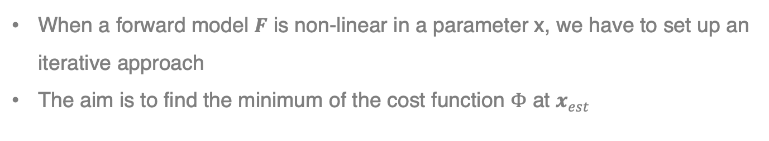




Gauss-Newton Iteration
When a forward model $F$ is non-linear in a parameter x, we have to set up an iterative approach
The aim is to find the minimum of the cost function $Φ$ at $x_{est}$
$$F\left(x\right)=F\left(x_{0}\right)+\frac{∂F}{∂x}\left(x_{0}\right)\left[x−x_{0}\right]+ 𝒪\left(Δx^{2}\right)$$
$$F$$
$$Φ$$
$$x_{est}$$
$$x_{1}$$
$$x_{0}$$
$$x_{est}$$
$$x_{2}$$
$$x_{1}$$
$$x_{0}$$

Slide 10




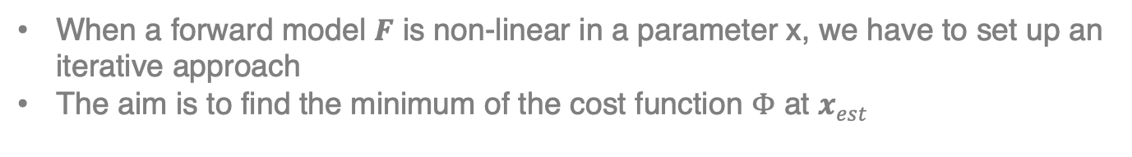








Gauss-Newton Iteration
When a forward model $F$ is non-linear in a parameter x, we have to set up an iterative approach
The aim is to find the minimum of the cost function $Φ$ at $x_{est}$
$$F\left(x\right)=F\left(x_{0}\right)+\frac{∂F}{∂x}\left(x_{0}\right)\left[x−x_{0}\right]+ 𝒪\left(Δx^{2}\right)$$
$$F$$
$$Φ$$
$$F$$
$$Φ$$
$$x_{est}$$
$$x_{1}$$
$$x_{0}$$
$$x_{est}$$
$$x_{2}$$
$$x_{1}$$
$$x_{0}$$

Slide 11
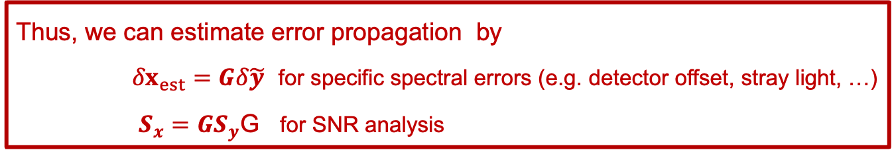
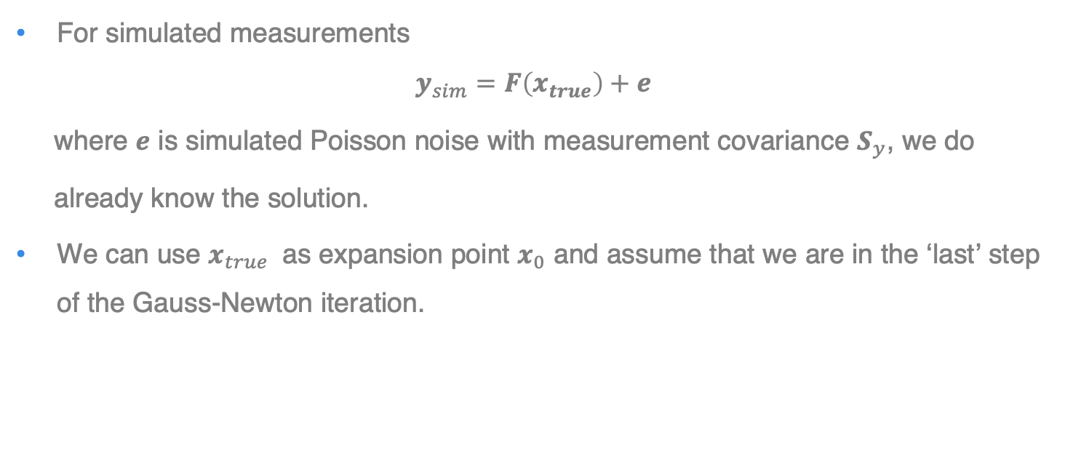
Linear error analysis: Final remarks
For simulated measurements
$$y_{sim}=F\left(x_{true}\right)+e$$
where $e$ is simulated Poisson noise with measurement covariance $S_{y}$, we do
already know the solution.
We can use $x_{true}$ as expansion point $x_{0}$ and assume that we are in the ‘last’ step of the Gauss-Newton iteration.
Thus, we can estimate error propagation by
${δx}_{est}=Gδ\tilde{y}$ for specific spectral errors (e.g. detector offset, stray light, …)
$S_{x}=GS_{y}$G for SNR analysis

